Slide 1
The Cell Processor
From conception to deployment
Presented by Nathan Lemieux
November 16, 2005
Created for CS625a @ UWO

Slide 2
Overview
Brief History of the Cell Conception
Cell’s Architecture
Comparisons to other Architectures
Design Decisions
Conclusions
Extra tidbits

Slide 3
History
Idea generated by SCEI in 1999 after release of PS2
STI group formed in 2000
In 2001 the first design center opened in the US
Fall 2002 US patent released
Since then prototypes have been developed and clocked over @4.5 GHz
February 2005 final architecture revealed to public
In 2005 announced that first commercial product of the Cell will be released in 2006

Slide 4
Sony Toshiba IBM Group (STI)
Sony
  Leading manufacture of consumer and professional audio and video products. Includes SCEI that produces PS consoles
Toshiba
  A Leader in development of consumer electronics such as HDTV and other devices
IBM
  Proven track record as a leader in manufacturing state-of-the art microprocessors

Slide 5
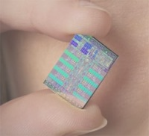
STI
Each bring different knowledge
Each have different Requirements and Expectations
  Power consumption
  Size
  Performance
  Scalability
  Cost

Slide 6
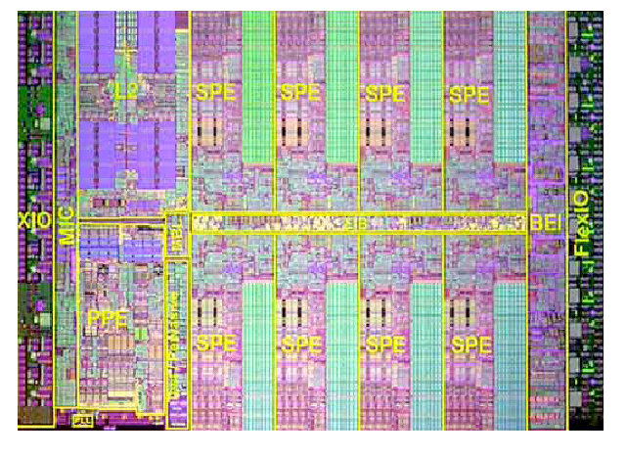
Cell Architecture Overview

Slide 7
Cell Architecture Overview
Continued
Intended to be configurable
Basic Configuration consists of:
  1 PowerPC Processing Element (PPE)
  8 Synergistic Processing Elements (SPE)
  Element Interconnect Bus (EIB)
  Rambus Memory Interface Controller (MIC)
  Rambus FlexIO interface
  512 KB system Level 2 cache

Slide 8
Power Processing Element (PPE)
Act as the host processor and performs scheduling for the SPE
64-bit processor based on IBM POWER architecture (Performance Optimization With Enhanced RISC)
Dual threaded, in-order execution
32 KB Level 1 cache, connected to 512 KB system level 2 cache
Contains VMX (AltiVec) unit and IBM hypervisor technology to allow two operating systems to run concurrently (Such as Linux and a real-time OS for gaming)

Slide 9
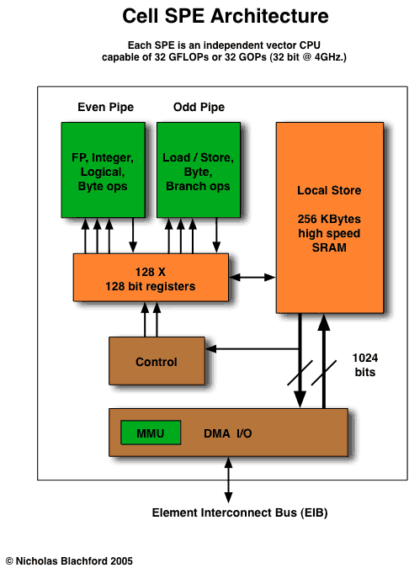
Synergistic Processing Unit (SPU)
SIMD vector processor and acts independently
Handles most of the computational workload
Again in-order execution but dual issue*
Contains 256 KB local store memory
Contains 128 X 128 bit registers
Notes:
Dual issue – increase performance, 2 operations 1 load, 1 calc performed simultaneously/concurrenlly

Slide 10
Synergistic Processing Unit (SPU)
Continued
Operate on registers which are read from or written to local stores.
SPE cannot act directly on main memory; they have to move data to and from the local stores.
DMA device in SPEs handles moving data between the main memory and the local store.
Local Store addresses are aliased in the PPE address map and transfers to and from Local Store to memory (including other Local Stores) are coherent in the system
Notes:
Conventional CPUs perform all their operations in registers which are directly read or written from main memory. Operating directly on main memory is slow, so this latency is why cache was introduced to hide the effects of going to or from main memory. Cache works by storing part of the memory that the processor is working on. If data is not present in the cache, the CPU waits for this data to be fetched.
Local Store is different from cache as it is not transparent to software and does not contain hardware structures that predict what data to load, leaving more real-state for execution hardware. The local store memory is aliased in the PPE address map and is closer to the execution units. However to take advantage of the Local store the programmer or compiler must pre-schedule data transfers. And since the SPE are dual issue, pre-scheduled data transfers occur asynchronously, in parallel with computation.

Slide 11
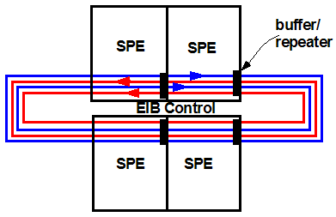
Element Interface Bus (EIB)
Contains 4 channels.
Each channel can transfer 24 bytes per cycle (16 bytes data + 8 bytes tag). For a total 96 bytes/cycle.
Enables communication between the SPEs and the PPE and is also connected to level 2 cache, memory controller and FlexIO
Great design to allows for different configurations*
Notes:
Data travels no more than the width of an SPE, so adding more or less results in transport latency equal to addition/reduced hops

Slide 12
Rambus Contributions
Memory Controller
  Dual channel Rambus XDR controller,
  peak memory bandwidth is 25.6 GB per second(2 channels x 2 devices per channel x 2 bytes per device x 3.2 GHz)
I/O Controller
  Rambus FlexIO is capable of running from 400 MHz to 8 GHz.
  Contains 12 lanes (5 lanes are inbound, 7 outbound, for a theoretical peak I/O bandwidth of 76.8 GB @ 8 GHz (44.8GB out, 32GB in)

Slide 13
Processing Power
8 (SPE) x 4GHz x 4 (32 bit words in a vector) x 2 (Multiply-Adds are counted as 2 operations) = 256 SP GFLOPS
Each SPE is capable of 32 SP GFLOPS
SPE can produce 2 DP FMADD operations every 7 cycles, ~2.3 DP GFLOPS, ~18.4 Total
These calculations do not include the processing power of the PPE

Slide 14
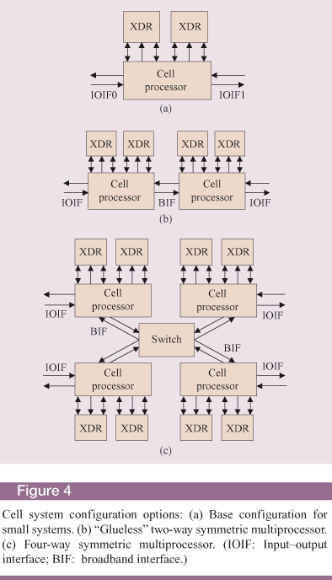
Architecture Wrap Up
Cell needs to be configured for different uses
Allows for variable number of PPEs and SPEs with different memory configurations
Newer generation Cells will be compatible to older generations
Cells are designed to work together; even distributed over a network

Slide 15
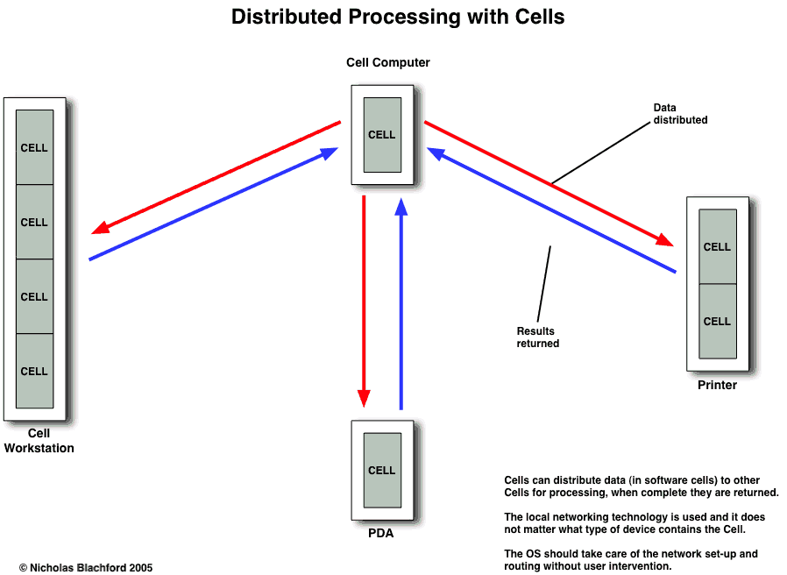

Slide 16
Architecture Wrap Up
Continued
Tasks are divided into SPE and PPE “modules” or jobs.
Different resource allocation schemes available
  PPE Scheduling – The PPE maintains a job queue
  SPE self Scheduling – Scheduling is distributed across the SPEs. PPE still maintans the job queue
  Stream Processing – Each SPE runs a distinct program to be chained together.

Slide 17
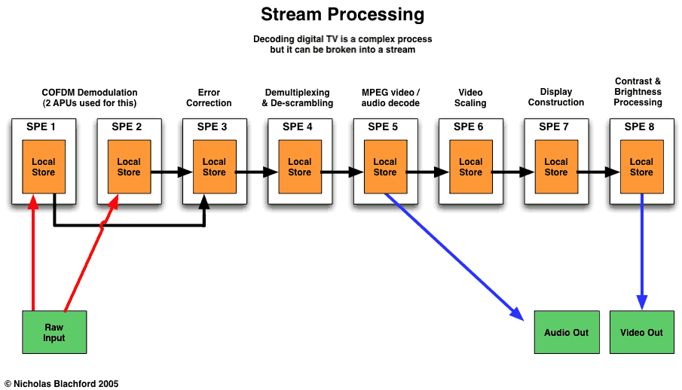

Slide 18
Processing Power
Continued
Supercomputers rankings are done by Double Precision calculations
Supercomputer BlueGene/L develop by IBM has a theoretical peak performance of 183500 GFLOPS but has only achieved 136800 GFLOPS. IBM’s BlueGene/L has 65536 processors giving each processor a theoretical peak performance of approximately 2.8 DP GFLOPS

Slide 19
Comparison To Other Architectures
x86
  CISC
  Contain multiple level of cache and OOO hardware
  Current trend is a dual-core approach
GPU
  Specific purpose
  Contain vertex/pixel units, which are similar to the SPE
  Connected to its own high speed memory

Slide 20
Design Decisions
STI members each have different expectations. but power consumption and performance are shared prerequisite amongst them
Different techniques OOO execution, branch predictions units and large cache have been developed to increase performance but the trade-off is increased complexity, power consumption, size and heat.
Because of the heat issue they are moving toward dual-core processors.

Slide 21
Design Decisions
Continued
STI removed and/or modified all the techniques other manufactures have used to increase performance but have reduced complexity & power consumption, space
To combat the reduced performance they looked at the memory latency issue and introduced local store memory that is closer to the execution units and used the extra space to insert more execution units and introduced a large resister file
Using a multi-core approach that is easily scaleable to multiple Cells
Since there is reduced power consumption and heat generation, the Cell clocked frequency can be cranked up

Slide 22
Conclusions
9 Core processor with revolutionary design
Very scaleable in design and flexible in it uses
Programming will more likely be difficult at first, but future compilers will hopefully make things more simple
Current POWER apps will port easily to the Cell
Will perform exceptionally well in its niche markets but may never be seen in a desktop PC

Slide 23
What’s Apple Doing?
Recently announced that they are no longer using the IBM’s PowerPC
Cell design changed from previous design to include larger PPE with more advanced VMX (AltiVec) unit
Giving up the chance to be the distributor of Cell based desktops, for power hungry Intel chips

Slide 24
Reasons?
PPC970FX failing to reach 3 GHz?
Shortages of PPC?
Higher cost of PPC processor?
Strategic Alliance?

Slide 25
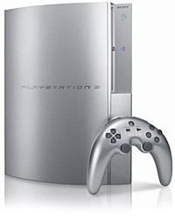
Sony’s PS3
Notes:
Dev Hardware Kit - Cytology

Slide 26
PS3 Specs
Cell processor @ 3.2 Ghz
7 functional SPE, but has 8 (Redundancy ?)
Total 218 SP GFLOPS
nVidia RSX GPU (1.8 TFLOPS)
256 MB XDR RAM
256MB GDDR3 VRAM
Up to 7 Bluetooth controllers
Backwards compatible, WiFi capabilities with PSP

Slide 27
?

